Slide 1

Nashville rock and roll marathons
The frostburners

Slide 2
What’s the difference?
By gathering and comparing the data we can identify trends and patterns.

Slide 3
Running
The Numbers

Slide 4
Running the Numbers
Race | Fastest Time | Slowest Time | Mean Time | Median Time
2016 Half-Marathon | 1:11:15 | 4:54:41 | 2:31:57 | 2:26:18
2016 Marathon | 2:25:42 | 7:00:00 | 4:47:48 | 4:45:19
2017 Half-Marathon | 1:10:58 | 6:18:24 | 2:43:59 | 2:39:34
2017 Marathon | 2:40:25 | 6:38:19 | 4:54:26 | 4:58:14
2018 Half-Marathon | 1:09:25 | 4:48:06 | 2:31:46 | 2:25:32
2018 Marathon | 2:28:16 | 6:34:41 | 4:48:23 | 4:48:21
2019 Half-Marathon | 1:10:03 | 5:03:35 | 2:32:07 | 2:26:07
2019 Marathon | 2:34:59 | 6:43:55 | 4:42:09 | 4:41:57
By using the MIN, MAX, AVERAGE, and MEDIAN functions on the time column for each year individually, we can begin to compare the races to one another.
Notes:
After creating a blank workbook and importing the data, we can start comparing each race to the others. Here we use the MIN, MAX, AVERAGE, and MEDIAN functions to assess the range, averages, and midpoints.

Slide 5
Running the Numbers
By using the AVERAGE and MEDIAN functions on the relevant time columns for each type of race collectively, we can also begin to see an overview of the races overall.
Overall | Time
Half-Marathon Mean | 2:35:15
Half-Marathon Median | 2:29:38
Marathon Mean | 4:48:27
Marathon Median | 4:48:53
Notes:
We can also get a snapshot of the races overall by using the AVERAGE and MEDIAN functions for all the time columns of each race.

Slide 6
Defeating
Oprah

Slide 7
Chasing Oprah: How Many Runners Beat 04:29:20?
Oprah Winfrey completed the 1994 Marine Corps Marathon in 4:29:20. Her time has become a popular benchmark for first-time marathoners.
👉 Target time: 4:29:20
Year | # of Runners | % of Finishers
2016 | 1099 | 37.23%
2017 | 615 | 24.94%
2018 | 756 | 36.00%
2019 | 793 | 39.20%
🔍 Insights:
We see a significant drop in 2017, where
only 25% of runners beat Oprah's time.
Notes:
In 1994, Oprah Winfrey completed the Marine Corps Marathon in 4 hours, 29 minutes, and 20 seconds. That time has since become a motivational benchmark for many first-time marathoners.
Here, we analyzed how many runners beat Oprah’s time in each year from 2016 to 2019. We noticed a significant drop in 2017, where
only 25% of runners beat Oprah's time.

Slide 8
Drawing
The Quartiles

Slide 9
Half Marathon Finish Time Quartiles (2016–2019)
1st Quartile (Q1): Fastest 25% of runners finished under this time
2nd Quartile (Q2): Median time — half the runners finished below this time
3rd Quartile (Q3): 75% of runners finished below this time
Year | Q1 25% | Q2 50% | Q3 75%
2016 | 2:08:18 | 2:26:18 | 2:50:11
2017 | 2:18:17 | 2:39:34 | 3:05:10
2018 | 2:07:21 | 2:25:32 | 2:51:16
2019 | 2:07:04 | 2:26:07 | 2:51:30
🔍 Insights:
2017 had noticeably slower finish times in all quartiles
Notes:
To better understand the distribution of finish times in the half marathons, we calculated quartiles for each year from 2016 to 2019.
As we were calculating the quartiles, we noticed that 2017 stands out as the slowest year across all quartiles.

Slide 10
Expectations
VS Reality

Slide 11
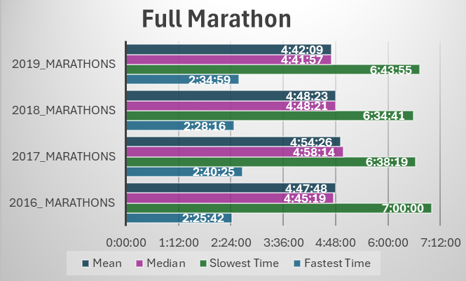
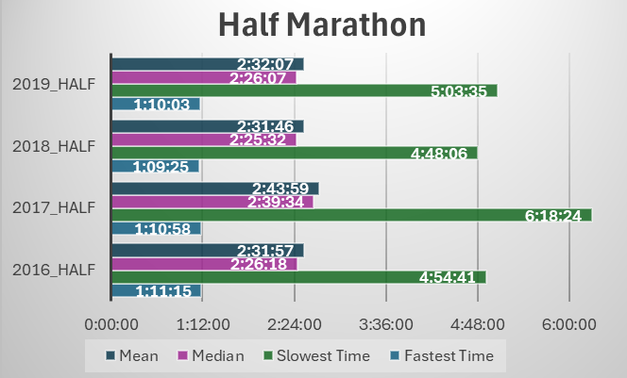
Fastest Years
Fastest Years:
Full Marathon → 2019
Half Marathon → 2016 & 2018 (within 11 seconds)
Top Quartile: Slight improvement from 2017-2019
2019 vs. 2017: Slight gains, but not as strong as 2016 or 2018
Median Times: Stable across years (2:25-2:40)
SloweST Year - 2017
Slower Averages: Especially in the half marathon
Outliers:
12 slower outliers in 2017
1 runner: 30 mins slower than all other runners
New Runners: Possible large group of first time participants
Performance Dip:
Only 25% beat Oprah's time
All quartiles showed slower finish times
Notes:
In reviewing the marathon performance trends, 2019 stands out as the fastest year for the full marathon, while 2016 and 2018 had nearly identical top results for the half marathon, with just an 11-second difference. Over the years, the top quartile has shown steady improvement, especially from 2017 to 2019, although 2019 didn’t quite match the strength of 2016 or 2018. The median times remained stable between 2:25 and 2:40. The slowest year was 2017, with slower averages, especially in the half marathon. Possibly due to a large number of first-time runners, since we found 12 outliers with much slower times in 2017 including one who's time was 30 mins slower than the next runner.

Slide 12
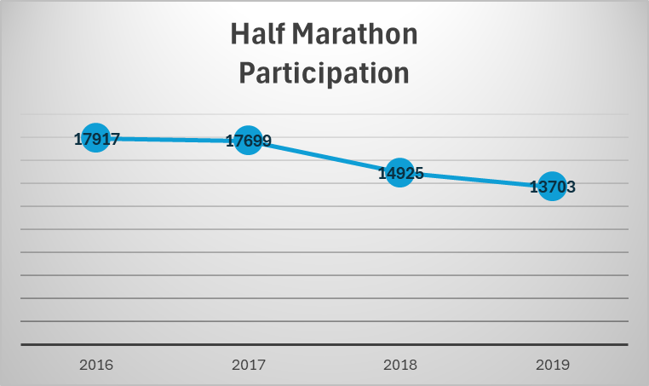

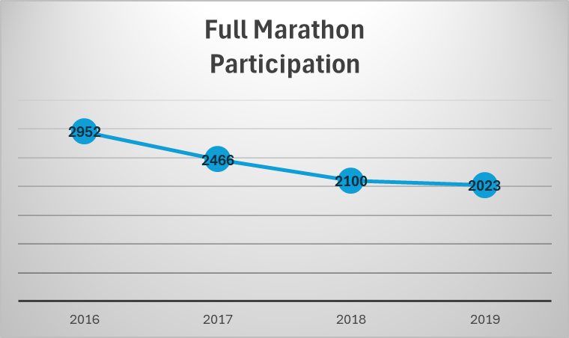
Other Observations
half marathons have considerably more participants than full marathons
fewer runners in 2018 and 2019 for both half and full
decline in runners throughout all 4 years for both races.
Notes:
We also made some observations related to participation. Half marathons consistently attract more participants than full marathons, but there was a clear decline in both events, especially in 2018 and 2019.

Slide 13
Hypothesis
Researched Weather Impacts in April 2017
91F, compared to 65-70F most years
hottest April to date
substantial winds up to 25mph
front of a severe storm, lots of damage the next day
Severe weather in Nashville during late April 2017 led to slower performance among all runners and a higher proportion of slow runners compared to other years, contributing to overall slower race times.
Notes:
After reviewing all the data, we decided there must be another factor that would explain the significant drop in performance in 2017, which lead us to research the weather during each race. In late April 2017, Nashville experienced unusually hot temperatures reaching a high of 91°F, compared to the usual 65-70°F. This was the hottest April in Nashiville to date! On this day, there were also strong winds up to 25 mph, which was the beginning of a severe storm, which caused significant damage the next day. This likely contributed to slower performance, especially among outlier runners, leading to an overall slower race time and a higher proportion of slow finishers that year. This additional research brought us to our hypthesis:

Slide 14
The winner’s
Edge

Slide 15
Scott Wietecha
Marathon Year | Wietecha Time | 2nd Place | Lead
2016 | 2:25:42 | Brian Shelton 2:34:43 | 0:09:01
2017 | 2:40:25 | Ryan Regnier 2:56:28 | 0:16:03
2018 | 2:28:16 | Grarang Madut 2:29:52 | 0:01:36
2019 | 2:34:59 | Jordan Wilson 2:35:24 | 0:00:25
How do runner up racers compare to the record setting athlete?

Slide 16
Conclusion
While the data indicates that severe weather contributed to broken trends, Scott Waitecha – though not unaffected – maintained his winning streak.

Slide 17
The Frostburners
Allyson​
Kyle
Michael
Nidhi

